Slide 1
SHT31 Temperature and Humidity Sensor with UNO

Slide 2
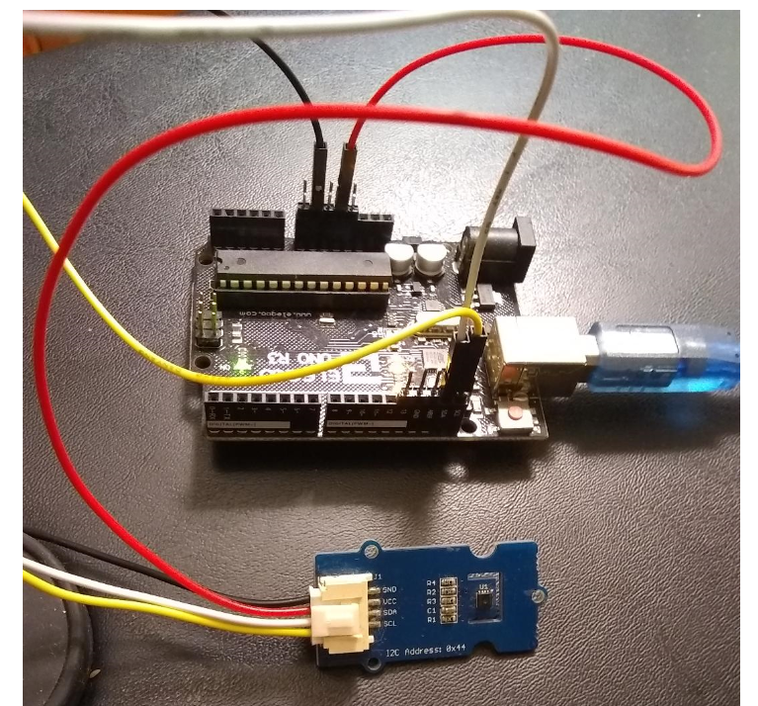
VCC = 5V, GND = 0V, SDA(white) /SCL (Yellow)

Slide 3
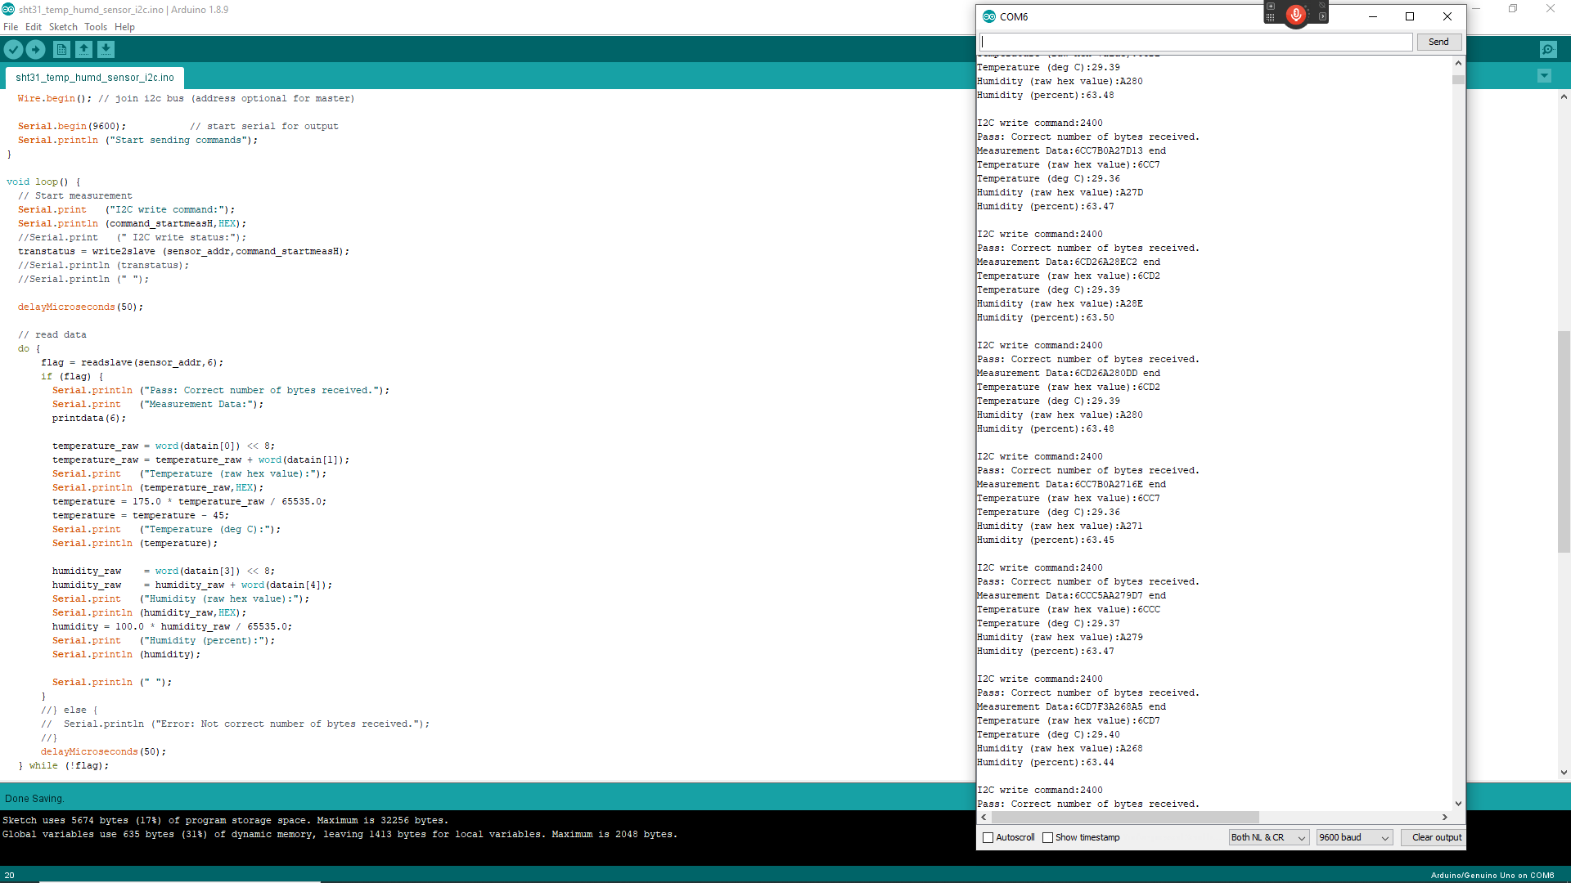
Serial Output

